Slide 1

DataDen: Web scraping with Python

Slide 2
Outline
Welcome to Workshop. Introduce Instructor
HTML Data Format
Use Cases for Web Scraping and APIs
Python Web Scraping Packages (BeautifulSoup, Selenium)
Live Coding Demo
Evaluation Form
Additional Learning Resources
Web Scraping Projects I have worked on.

Slide 3
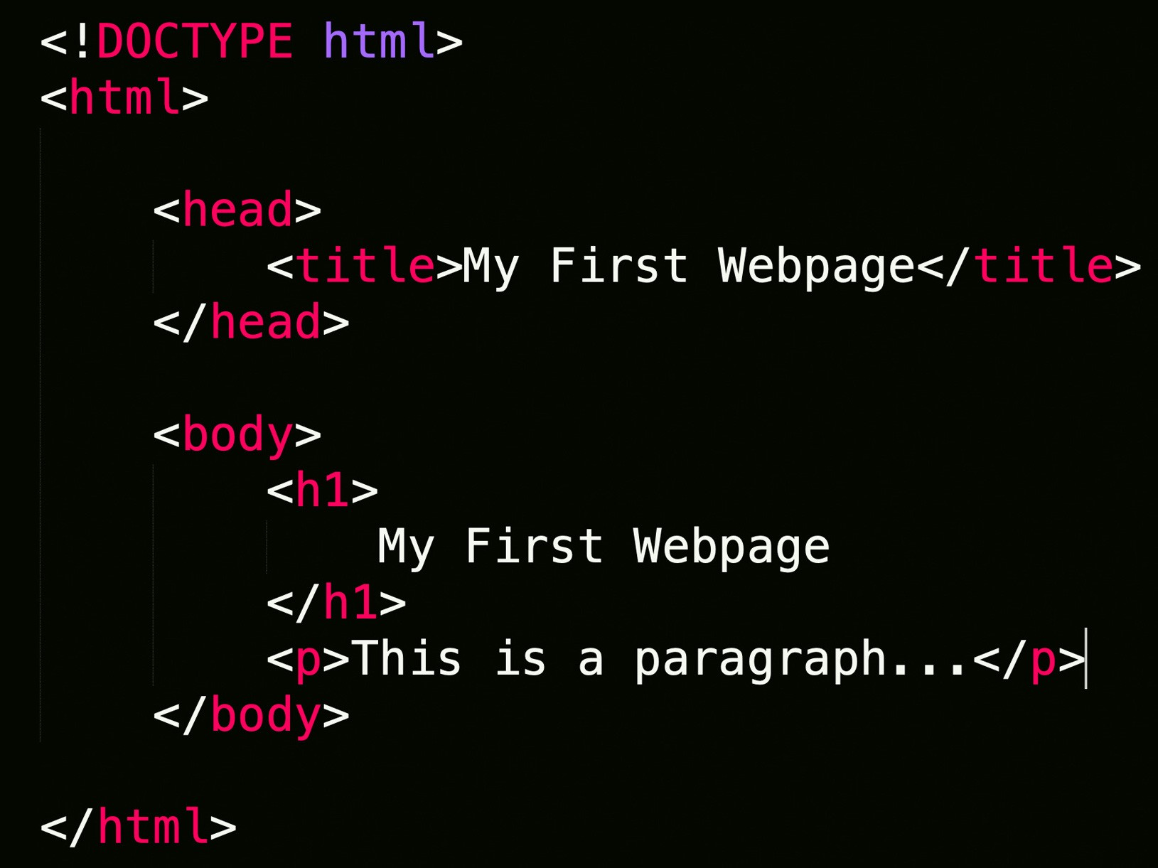
Web Scraping
Extraction of data from a website.
Loads HTML code from URL. User selects which content to keep

Slide 4
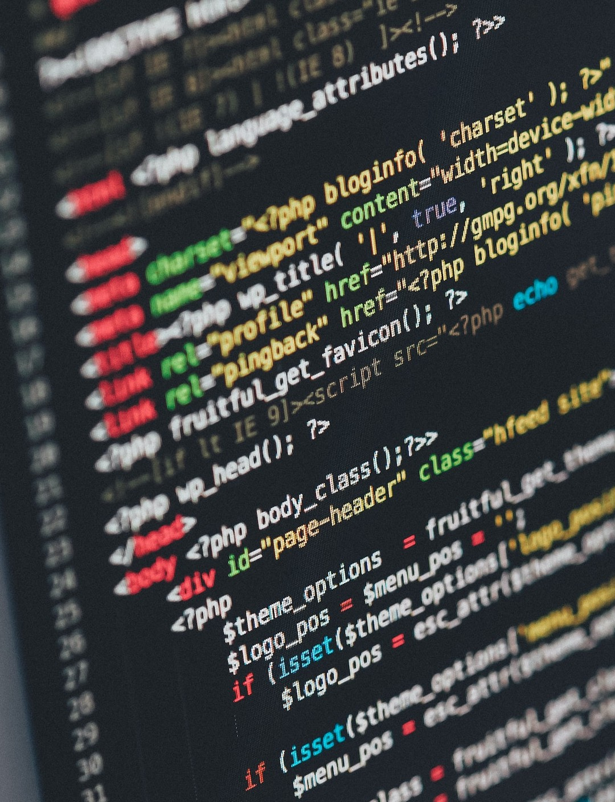

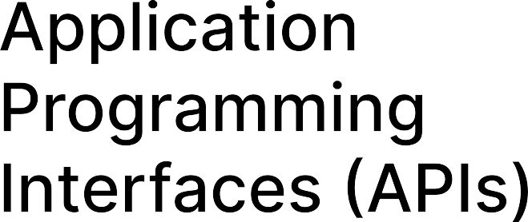
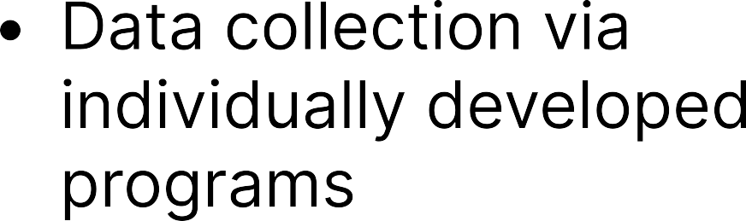

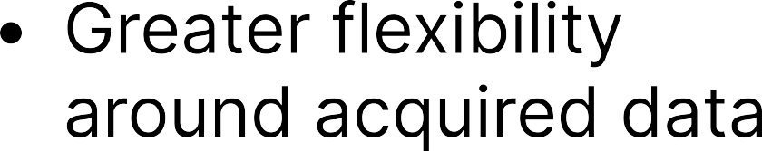
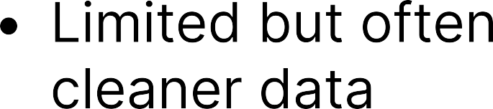
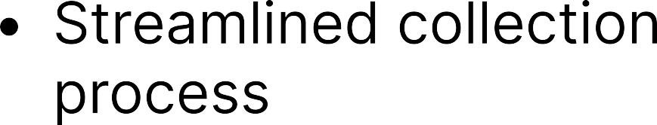
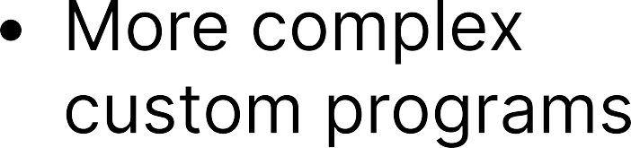

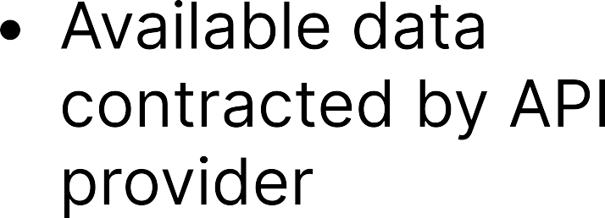
Web Scraping VS APIS

Slide 5


Most User Friendly. Less flexible
Navigates static webpages. Not able to interact with webpage
More complex, but greater flexibility.
Navigates webpage interactively. Allows clicking, entering text, etc.

Slide 6
Coding Demo
Github Page. Sample code through Binder.
Running code through Binder

Slide 7
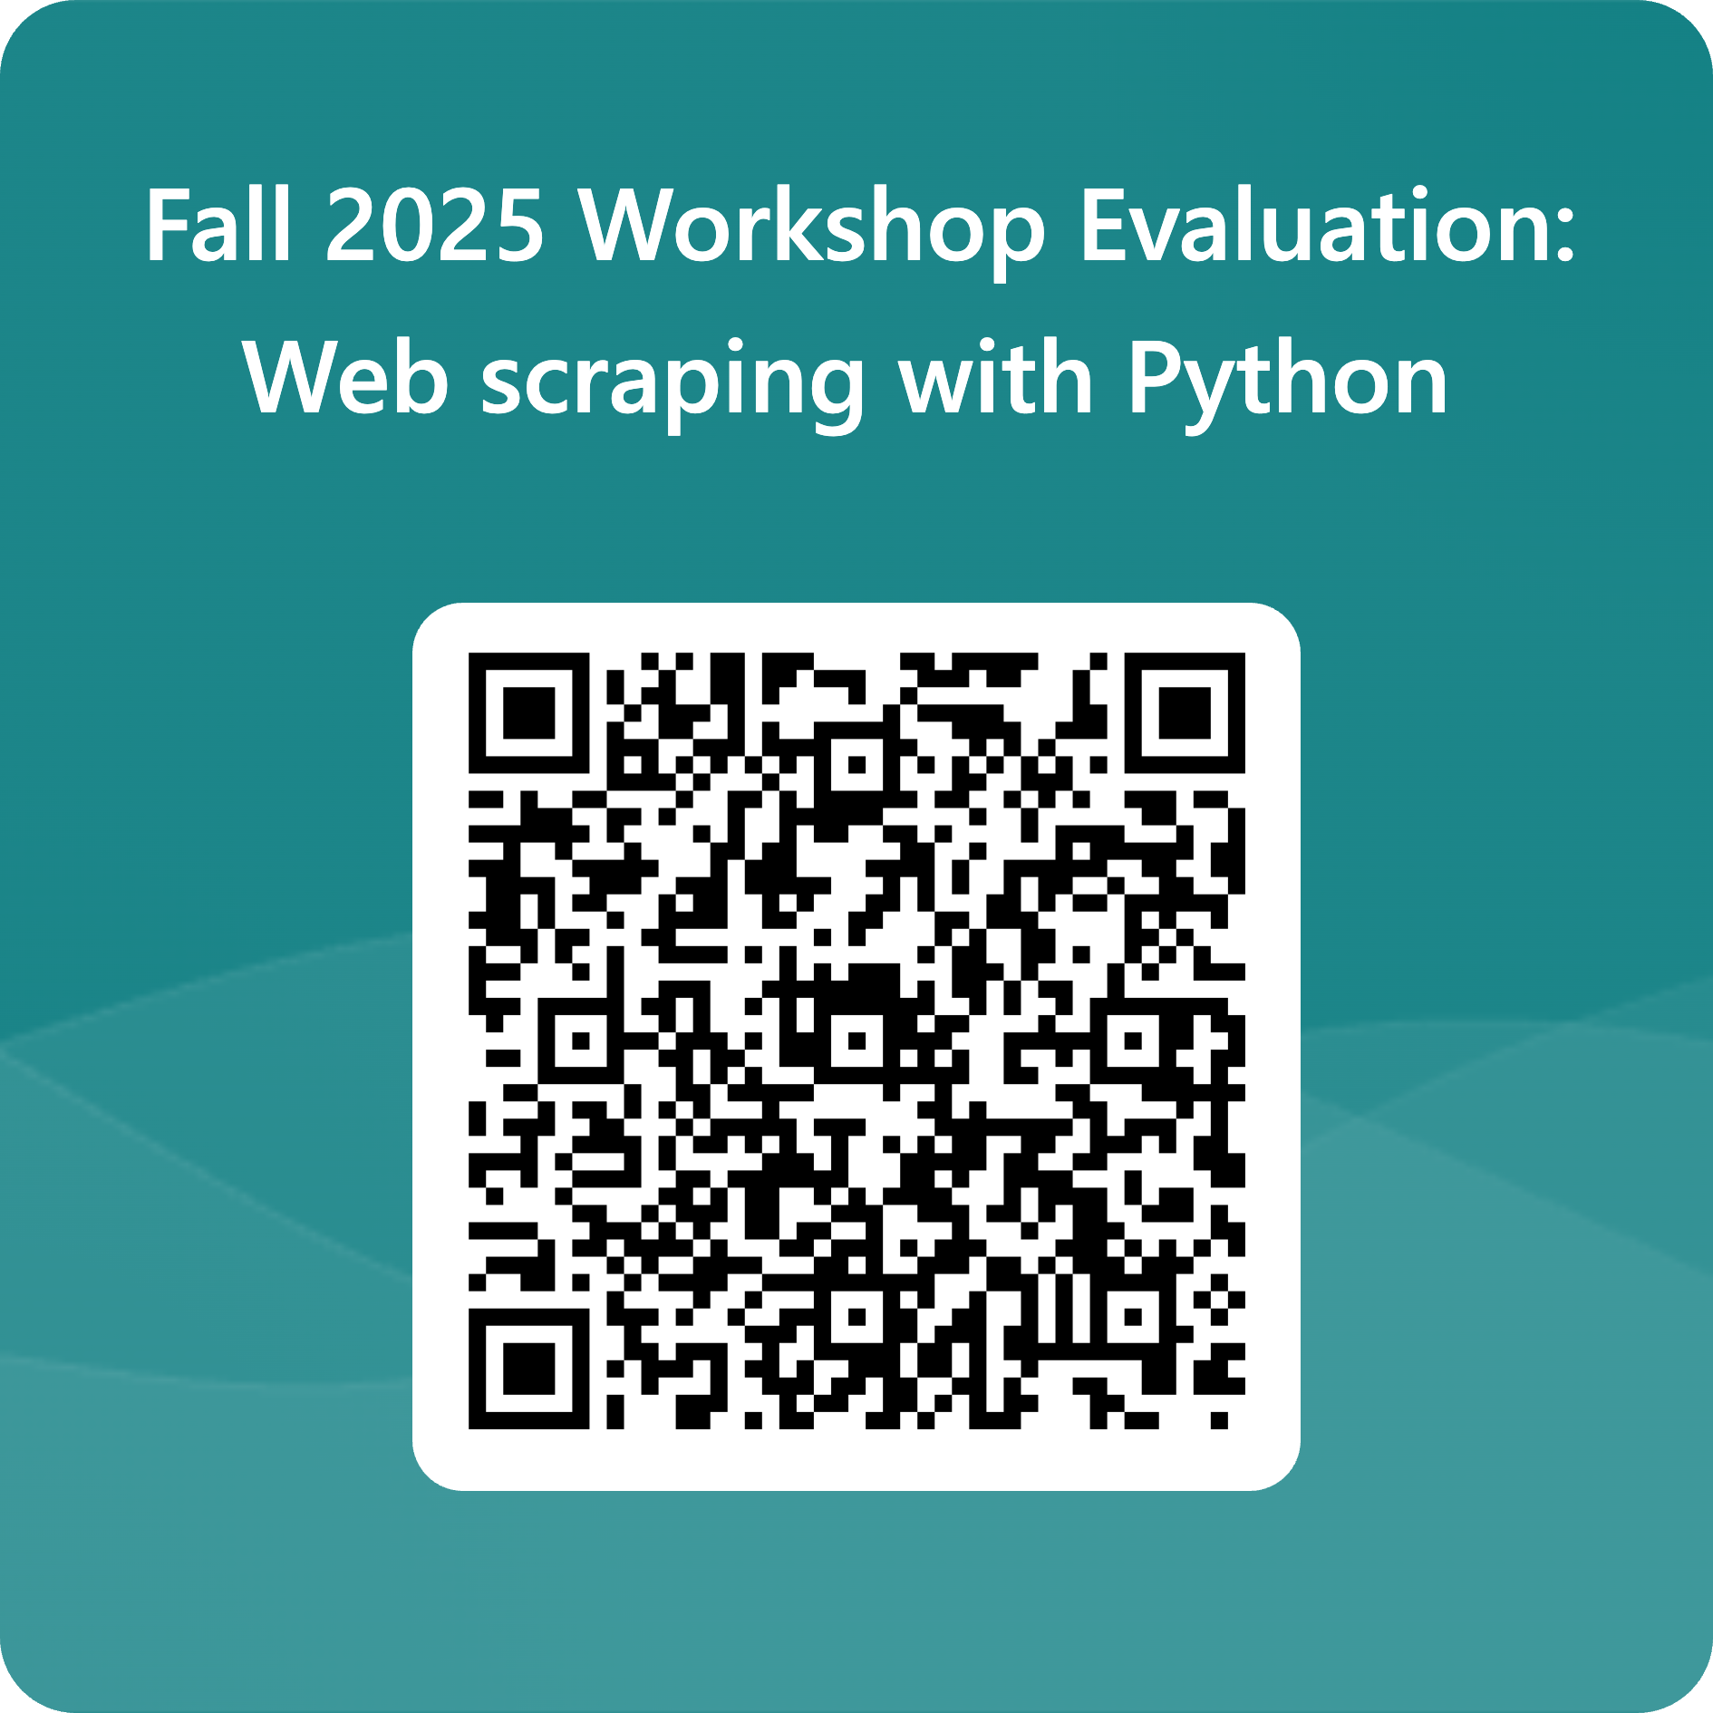
Evaluation

